Slide 1
Southside Surf Shop
Board Logo Possibilities

Slide 2


Slide 3


Slide 4
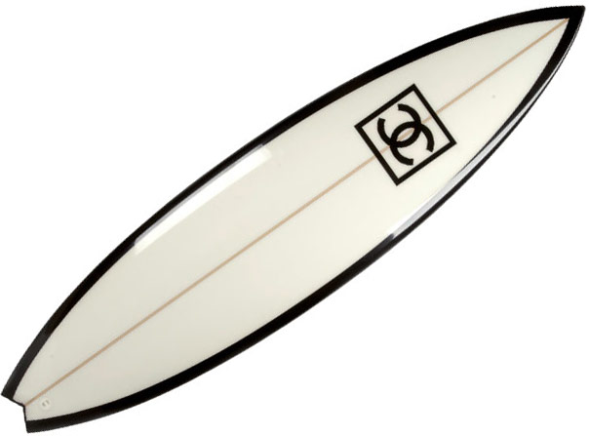

Slide 5
